Slide 1


Coffee Shop Data Analysis Dashboard

Slide 2


agenda
.
1. Data Cleaning and Transformation
2. Data Visualization
3. Insights using DAX and Pivot

Slide 3
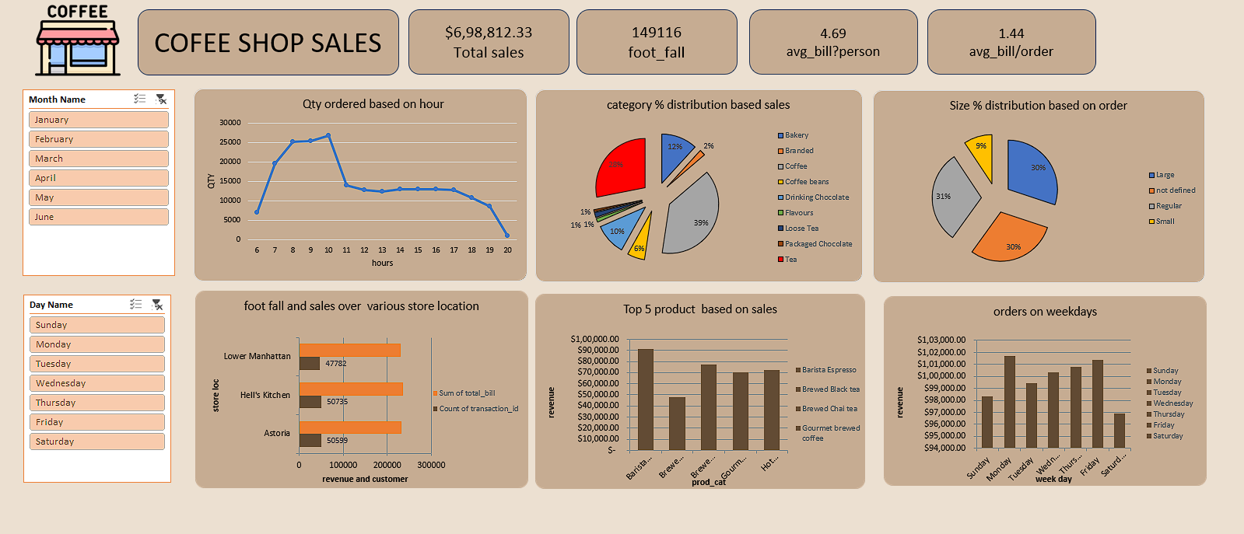

Slide 4

*Data Cleaning and Transformation in Power Query:*
Power query
1. transaction time column
I started by transposing the transaction time column to a time format.
2. conditional column for size
I added a conditional column for size based on the product details. I replaced values in the product detail column and trimmedthe text.
3. new columns
created new columns for total bill, day name, hour, day of the week, month number, and month name

Slide 5

Data Cleaning in Power Query:
Converted transaction_time to time format.
Added a Size column based on product deails (Large, Regular, Small, or Not Defined).
Removed size codes (Lg, Rg, Sm) from product_detail.
Trimmed extra spaces in product_detail.
Calculated total_bill as transaction_qty multiplied by unit_price.
Added Day Name column based on transaction_date.
Extracted Hour from transaction_time.
Added Day of Week column from transaction_date.
Added Month column from transaction_date.
Added Month Name from transaction_date

Slide 6
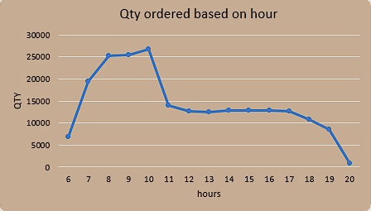
Qty ordered based on hours
Tourists
Customer Segmentation
hours | Sum of transaction_qty
6 | 6865
7 | 19449
8 | 25197
9 | 25370
10 | 26713
11 | 14035
12 | 12690
13 | 12439
14 | 12907
15 | 12923
16 | 12881
17 | 12700
18 | 10826
19 | 8595
20 | 880
Grand Total | 214470
created a line chart using a pivot table with hour as the row and sum of quantity as the value field. -This visualization helps identify peak sales hours, enabling better staffing and inventory management decisions.

Slide 7
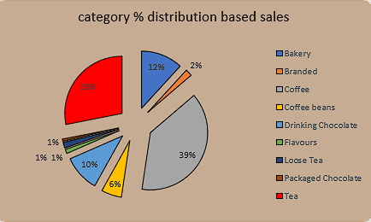
Category % distribution based on sales
top 5 product type | Sum of total_bill
Barista Espresso | $ 91,406.20
Brewed Black tea | $ 47,932.00
Brewed Chai tea | $ 77,081.95
Gourmet brewed coffee | $ 70,034.60
Hot chocolate | $ 72,416.00
Grand Total | $ 3,58,870.75
a pie chart using a pivot table with product category as the row and of sum of total bill as the value field.
- Understanding which product categories contribute most to revenue is crucial for product assortment and marketing strategies.

Slide 8
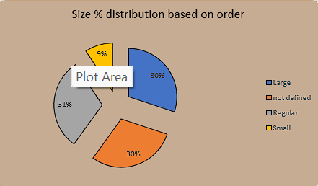
Size % distribution based on order
Tourists
Customer Segmentation
size | Count of transaction_id
Large | 44885
not defined | 44518
Regular | 45789
Small | 13924
Grand Total | 149116
a pie chart using a pivot table with size as the row and count of transaction id as the value field. Insights into customer preferences for different size options inform pricing and portioning decisions.

Slide 9
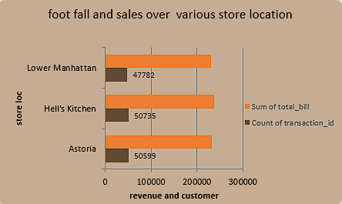
Foot fall and sales over various store location
Tourists
Customer Segmentation
store location | Count of transaction_id | Sum of total_bill
Astoria | 50599 | 232243.91
Hell's Kitchen | 50735 | 236511.17
Lower Manhattan | 47782 | 230057.25
Grand Total | 149116 | 698812.33
a bar chart using a pivot table with store location as the row and count of transaction id and sum of total bill as the value fields. - Implications for store management and resource allocation are discussed based on performance metrics.

Slide 10
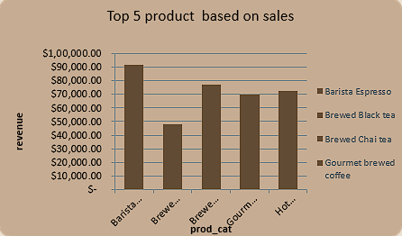
Top 5 products based on sales
Tourists
Customer Segmentation
top 5 product type | Sum of total_bill
Barista Espresso | $ 91,406.20
Brewed Black tea | $ 47,932.00
Brewed Chai tea | $ 77,081.95
Gourmet brewed coffee | $ 70,034.60
Hot chocolate | $ 72,416.00
Grand Total | $ 3,58,870.75
a column chart using a pivot table with product type as the rows and sum of total bill as the value field. - Identifying top-selling products guides inventory management and promotional efforts.

Slide 11
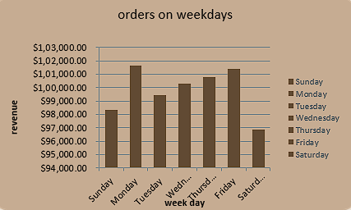
Top 5 products based on sales
Tourists
Week days | Sum of total_bill
Sunday | $ 98,330.31
Monday | $ 1,01,677.28
Tuesday | $ 99,455.94
Wednesday | $ 1,00,313.54
Thursday | $ 1,00,767.78
Friday | $ 1,01,373.00
Saturday | $ 96,894.48
Grand Total | $ 6,98,812.33
a column chart using a pivot table with day name as the rows and sum of total bill as the value field.
- Trends in daily sales and potential influencing factors are discussed for operational optimization.

Slide 12
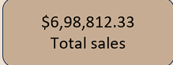
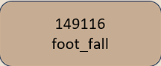
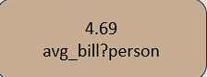
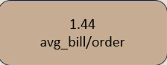
Top 5 products based on sales
Total Sales:
Sales = SUM([total_bill])
Footfall (Unique Customers)
Footfall = DISTINCTCOUNT([transaction_id])
Average Bill per Person:
AverageBillPerPerson = SUM([total_bill]) / DISTINCTCOUNT([transaction_id])
Average Bill per Order:
AverageBillPerOrder = SUM([transaction_qty]) / DISTINCTCOUNT([transaction_id])

Slide 13

Conclusion :
Understand hourly sales patterns, identify peak times, and optimize staffing and inventory accordingly.
Evaluate product category performance and drive marketing and promotion strategies.
Analyze size distribution to understand customer preferences and adjust offerings.
Assess store location performance to make informed decisions on operations and potential expansions.
Review sales by product type and day to tailor product availability and enhance customer satisfaction.

Slide 14


Thank you
Contact us at
Santosh
Santoshgowdru15@gmail.com
https://github.com/SantoshSG99/cofee-shop-data-analysis-using-excel-.git
6361315309

